Slide 1

BlockChain Developer Project
Property Transfer

Slide 2
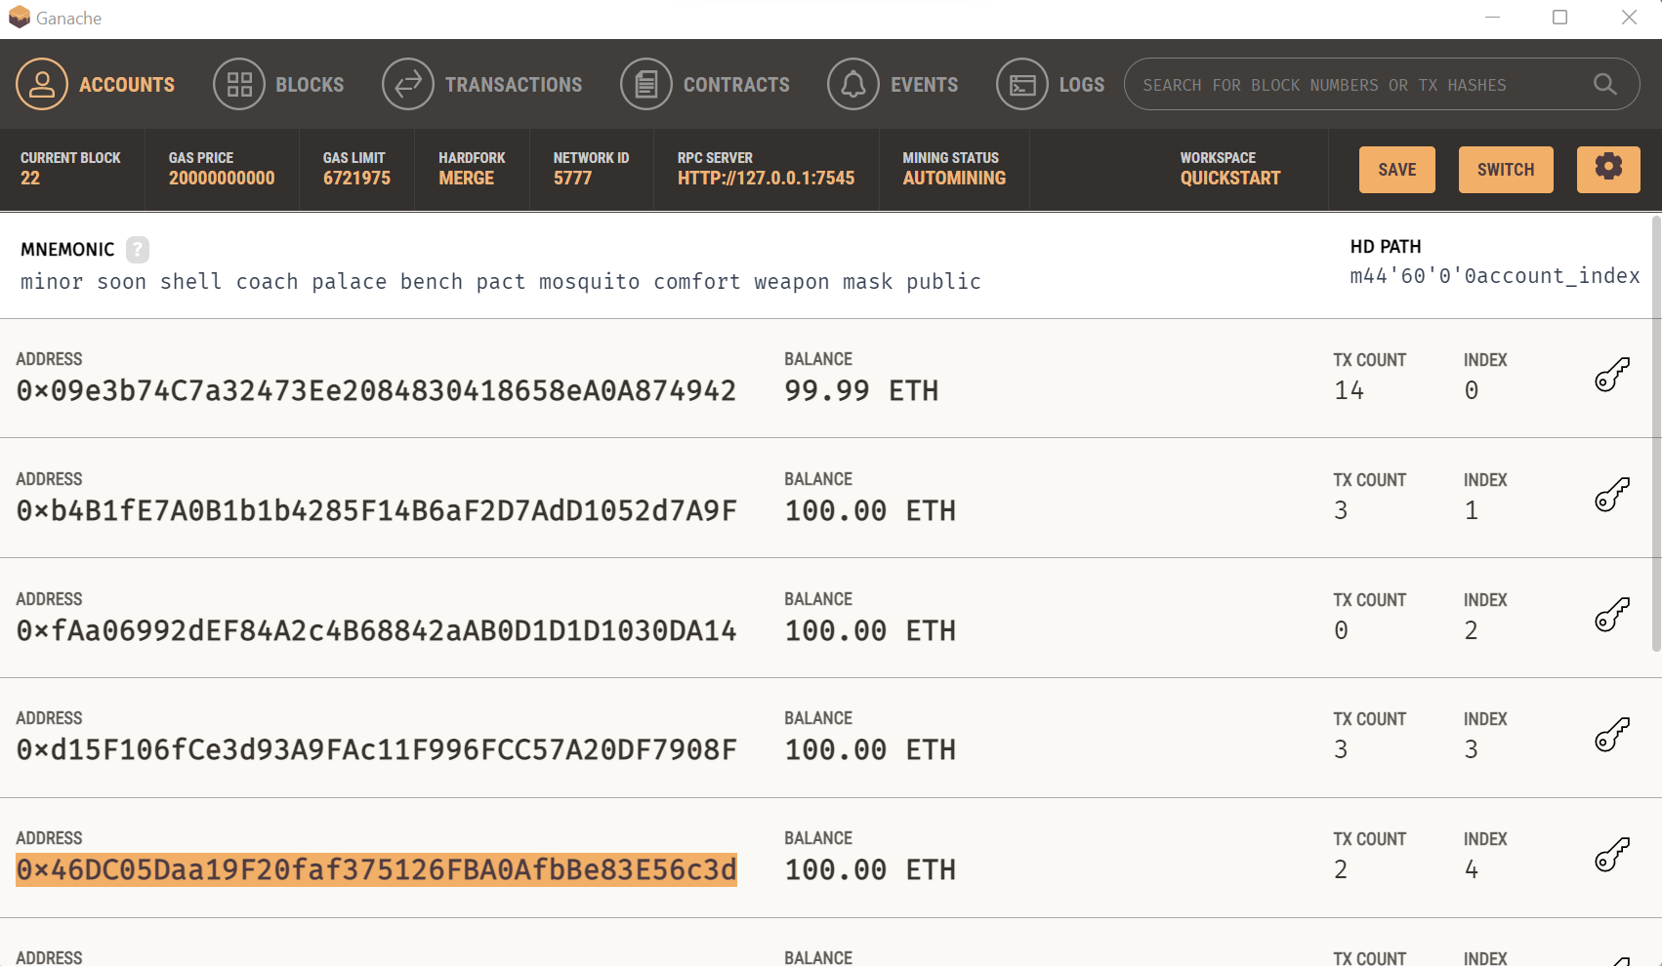
EVM Setup with Ganache

Slide 3
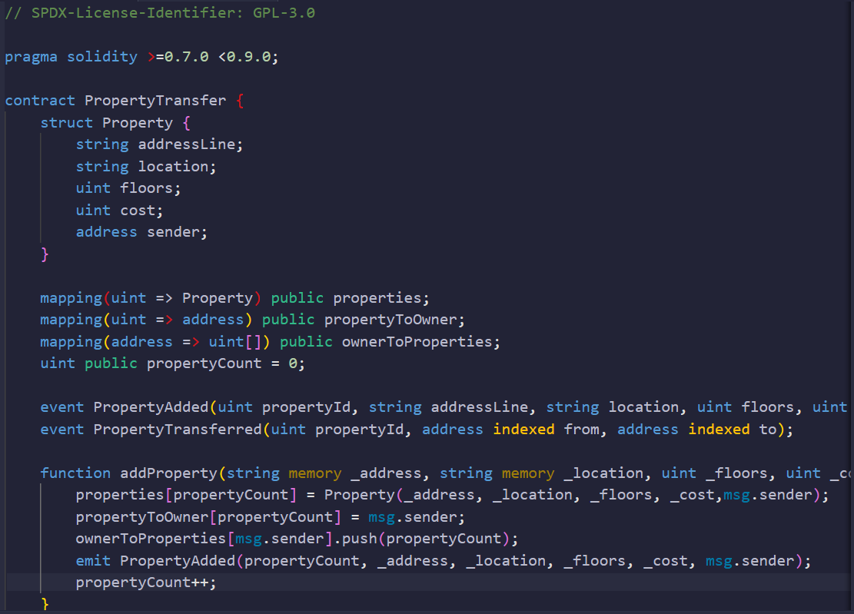
Smart Contract Information
Property Transfer

Slide 4
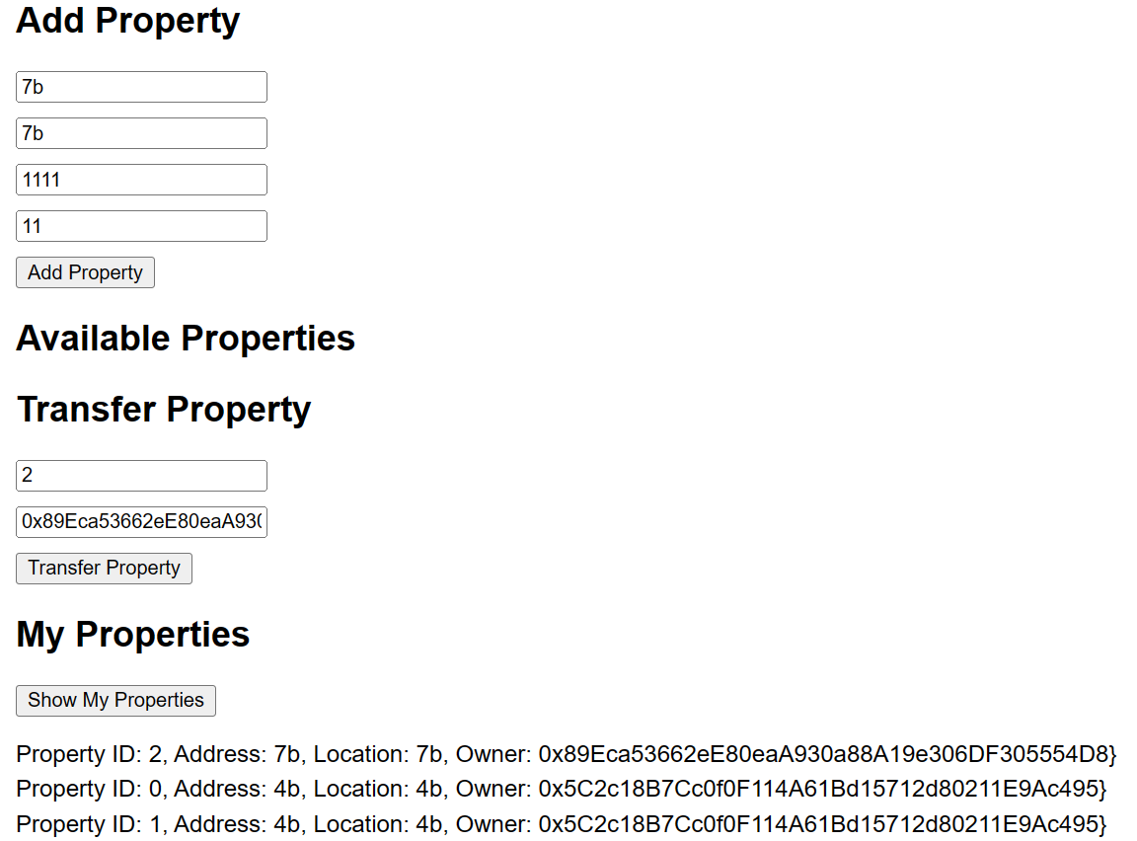
Property Form Setup

